Slide 1

Micrsoft Dynamics CE Presentation by Raji Mariam

Slide 2


Topics Covered
Workflows/Business Rules/Javascript
Dynamics 365 Customization
Solutions
Power Pages
Power Automate
Reporting

Slide 3
Streamlined Prospects/Student Onboarding Hub using Dynamics 365 and Power Platform
Overview
The Student Onboarding solution is designed using the Microsoft Power Platform, specifically leveraging Dynamics 365 Customer Engagement (Model-Driven App), Power Pages, and Power Automate. This solution addresses the manual challenges associated with enrolling new students, reducing delays and increasing visibility across departments.
Objective
To implement a seamless, automated, and secure student onboarding process by:
Capturing student data through Power Pages
Creating onboarding requests automatically
Guiding the user via a custom business process
Reporting Capabilities
Core Components
Model-Driven App: “EduTech Hub"
Custom Table: Student Table, Program Table
Custom View: "New Requests This Today“, “All Approved Students Requests“, “All Rejected Students Requests“.
Portal Integration: Power Pages form for student self-registration
Power Automate Flows: Automates onboarding record creation and email notifications
Reporting Dashboard to track students' requests and for visibility

Slide 4
Streamlined Student Onboarding using Dynamics 365 and Power Platform
Functional Highlights
Custom Entity: Student Onboarding Request with fields like Request Status, Program Applied, Assigned Officer, Student KYC details.
Custom View: List of active onboarding requests filtered by status.
Business Process Flow: Structured steps from “Review" > "Documents Collected" > "Approval" > "Complete"
Email Notifications: Triggered by Power Automate for both staff and student
Security Role Configurations: Restrict visibility of sensitive data to authorized roles only. Also, custom security profiles.
Process Flow (User Journey)
Student visits portal and submits onboarding form.
Power Automate is triggered upon submission.
A Student record notification and linked Onboarding Request are created.
Admissions team receives email and opens request in the Model-Driven App.
Business Process Flow guides staff through review, approval, and completion.
Value & Benefits
Reduced Administrative Overhead: Removes manual data entry tasks
Improved Data Accuracy: Validation at portal level
Real-time Tracking: Admin can track onboarding pipeline
Role-based Access: Ensures compliance and security

Slide 5
Dynamics 365 Business Uses Cases.
Student Form
Custom Web and Students form, which includes Column Security to protect data from unauthorised users
Business Process Flow
03
04
Captured use case scenario on Lead to Opportunity Process
Business Rules/Duplicate Detection Rule
02
05
Form Validation Using Javascript
Ensure Form Validation on Student Data Capture
To handle form validation
Workflows
01
06
Views Customization
Created Workflows for BPF automation
Custom views

Slide 6
Power Pages (students onboarding process )
Student receives notification with status of admission
Student details captured on Power Pages
Notification is received by student/Notification is received request is received
SLA Timer
Review/Validate Document Sent/Approval
Student details captured on Power Pages
Notification is received by student/Notification is received request is received
SLA kicks in
User Reviews/Validate Document Sent/Approval
Student receives notification with status of admission
Close

Slide 7
Dataverse Tables
Student Entity
Program
Field Name | Type | Description
First Name | Text | Student’s first name (Primary Column)
Last Name | Text | Student’s last name
Email | Email | For communication
Phone | Phone | Optional
Application Date | Date Only | When the student applied
Admission Status | Choice | Submitted, In Progress, Complete, Rejected
Program Applied For | Lookup (Program) | Link to course or program
Send Email | Yes/No | Boolean
Portal Registration ID | Autonumbering | Students Registration Number
Field Name | Type | Description
Program Name | Text | Programs a Student can apply for

Slide 8
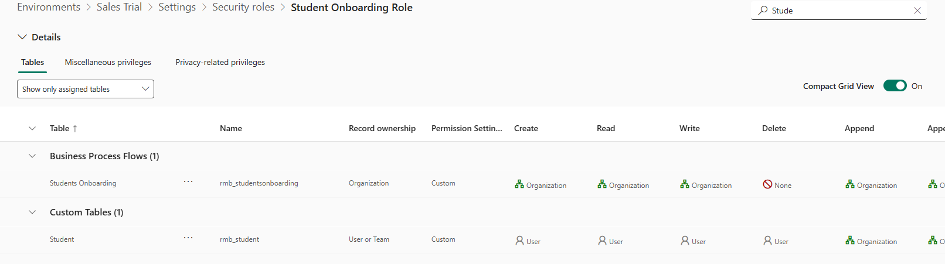
Security Role/Security Profiles
Custom Security Role: Student Onboarding Role. this was assigned to a user (Berger Germany).This is to protect/control access to records on the application

Slide 9
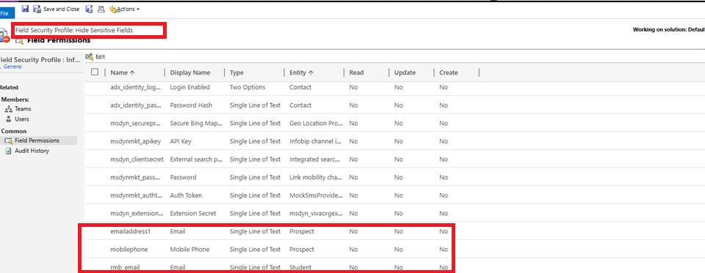
Security Role/Security Profiles
Custom Security Role: Student Onboarding Role. this was assigned to a user (Berger Germany).This is to protect/control access to records on the application

Slide 10
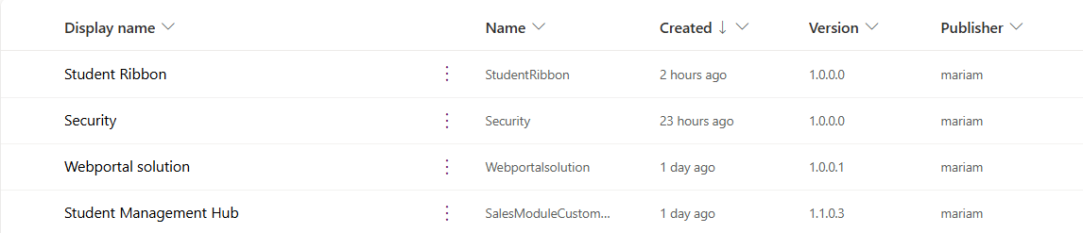
Solution Components

Slide 11
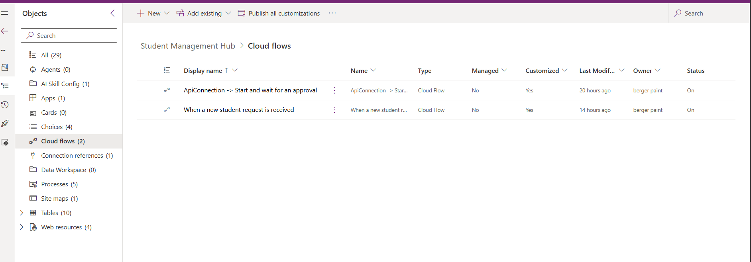
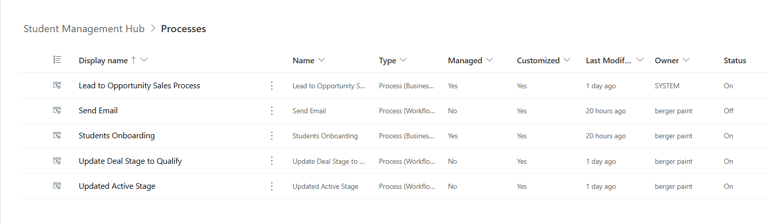
Power Automate/Workflows

Slide 12
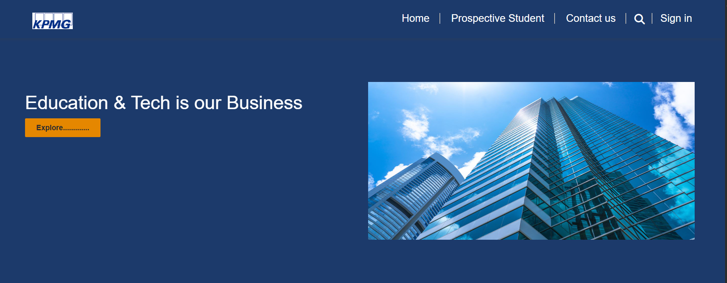
Snapshot from Power Pages

Slide 13
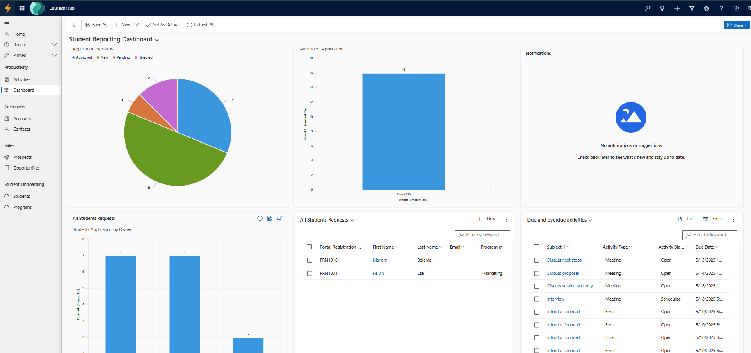
Snapshot on Reporting

Slide 14
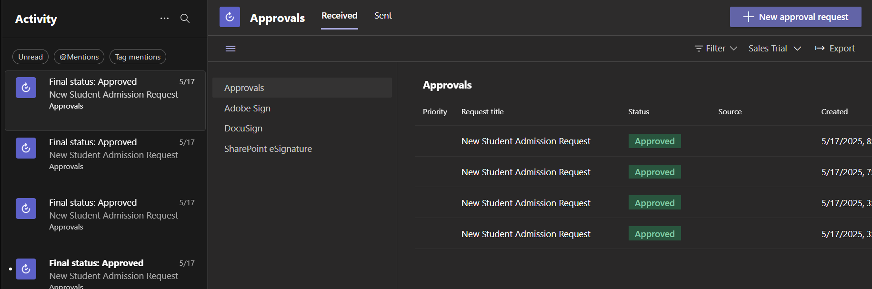
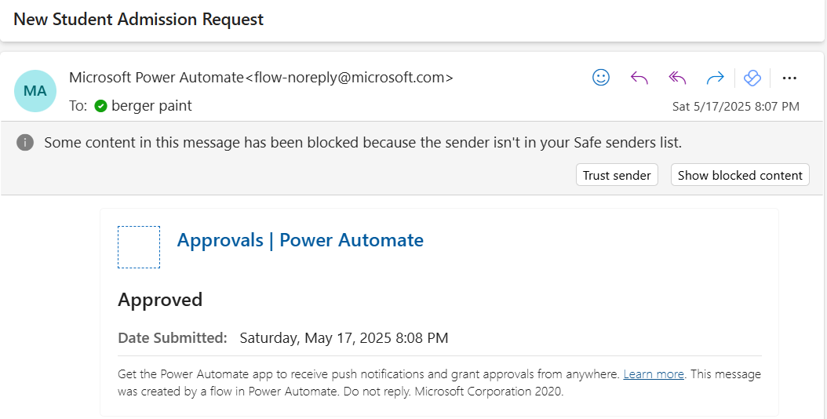
Snapshot Approval Notifications on Teams/Outlook

Slide 15
Thank You

